Slide 1
Crunchbase Rank Prediction using Linear and Ensemble Regression Methods Group 8

Slide 2
Project analysis slide 2
Presentation Outline
OUR DATA AND OBJECTIVE
DATA EXPLORATION
PROJECT
IMPUTATIONS AND HYPERPARAMETERS
MODELS
TESTING AND ACCURACY
EVALUATION AND CONCLUSION

Slide 3
Project analysis slide 3
Our Data and Features
Our data consists of 1000 rows, a company name column, 7 features and a target label which is the company’s Crunchbase rank.
Crunchbase is an independent company information platform providing insight mostly about the startup ecosystem.
Minimum Estimated Revenue
Last Funding Amount
Total Funding Amount
Number of Investors
Money Raised at IPO
Valuation at IPO
Trrend Score
(Last 90 Days)

Slide 4
Our Objective
Our objective is simple:
Can the crunchbase default database be utilized to make predictions on the company’s Crunchbase rank?
If so, can we build a viable model with predictive capabilities about the company’s success?

Slide 5
Project analysis slide 4
Our Imputation Structure
Our model predicts test data labels when provided features.
We used a variety of imputation methods and sometimes created an ensemble of methods to improve performance.
Predictions
Imputation method 1
Both models provide insight about feature importances.
Clean Data with no NaN entries
Our Model
Feature Importances
Imputation method 2
Since our models do not allow for missing data points, our data is now ready after preprocessing
We used 2 different models
Our conclusions are mostly based on our Accuracy metrics.
Accuracy Metrics

Slide 6
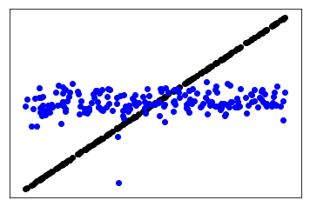
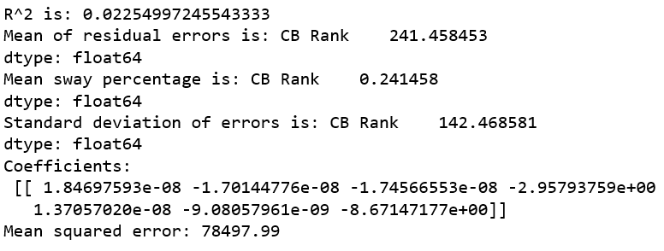
Project analysis slide 5
Linear Regression Model
Performance Metrics & Error Outputs
OUR MAX R^2
MEAN SQUARE ERROR
METHOD OF IMPUTATION
~0,02
~78.5k
GLOBAL MEDIAN
Linear Regression model does not provide a comfortable explained variance score for further analysis.
Our mean square error is still too high to be operable. The mean sway and the standard deviation of errors does not seem comforting either even though global median imputation provides the lowest values for these errors.
Substituting the missing data with the global median provides the best Accuracy Measures.

Slide 7
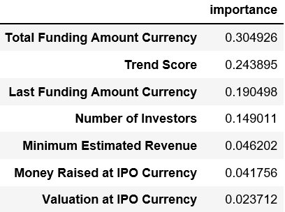

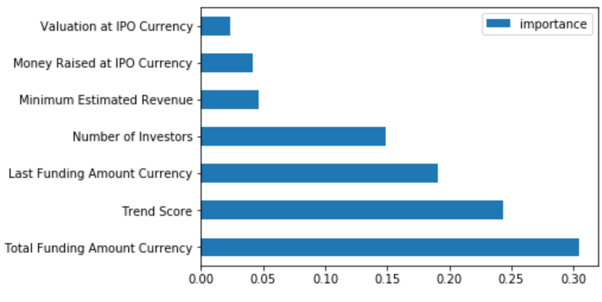
Project analysis slide 5
Random Forest Regression Model
Performance Metrics & Error Outputs
OUR MAX R^2
MEAN SQUARE ERROR
METHOD OF IMPUTATION
~0,25
~57.7k
KNN>RR>MEAN
Random Forest Regression model provides a significantly higher R^2 score compared to Linear Regression but a 0.25 R^2 score is still not viable.
The mean squared error is significantly lower compared to our previous model but still at an undesired level.
KNN imputation followed by row reduction followed by global mean imputation provided the best performance metrics in our case.

Slide 8
Project analysis slide 6
Our Conclusions
Our dataset has a vast majority of missing datapoints and imputing a big portion of data points decreases Accuracy.
The methods we have utilized do not allow for operations with missing values.
Since countless iterations through imputation methods and post-hyperparameter tuning tests still do not provide desired levels of confidence, this dataset might not be a good predictor of Crunchbase rank.
Our biggest take is that we know which features to prioritize in investment decisions.
Also another conclusion is that missing data points greatly increase bias and reduce Accuracy significantly despite all the efforts to handle them.

Slide 9
Project analysis slide 10
LR Takeaways
Our Regression model especially revolves around the mean.
Considering the fact that the R^2 score implies that our model is hardly a better estimator than the global mean, this is not a good predictor of the rank.
In addition our sway is very close to the average sway of an arbitrary guess.

Slide 10
Project analysis slide 10
RF Takeaways
Our RF model is significantly better compared to the LR model..
Considering the fact that the R^2 score implies that our model is a better estimator than the global mean but still isn’t very reliable, this might not be a good predictor of the rank.
In addition our Mean Squared Error is still at an undesired level despite being significantly lower compared to Linear Regression.

Slide 11
Returning Back To Our Objective
Our objective is simple:
Can the crunchbase default database be utilized to make predictions on the company’s Crunchbase rank?
If so, can we build a viable model with predictive capabilities about the company’s success?
The dataset is not a good predictor of the rank although we have a good idea about feature importances.

Slide 12
Thank You

